Slide 1




Volunteering in Ireland
An overview
Stuart Garland
Learning & Capacity Building Manager,
Volunteer Ireland
Ljubliana, Tuesday 29 November 2022
stuart@volunteer.ie @VoluntIreland @StuartGarland

Slide 2
Who is Volunteer Ireland?
About Volunteer Ireland
Support body for all 29 Volunteer Centres In Ireland
Promote & celebrates volunteering in Ireland through campaigns and events
Support volunteer involving organisations in best volunteer management
Provide various services to the vot for profit & Corporate sectors

Slide 3
Definition of volunteering in Ireland
“Volunteering is any time willingly given, either formally or informally, for the common good and without financial gain.”
Formal volunteering - that which takes place within organisations (including institutions and agencies)
Informal volunteering - that which takes place outside an organisational setting; as well as: the individual who, in many cases, does not consider what they do as volunteering but sees their actions as ‘lending a hand’ or ‘being neighbourly’.

Slide 4
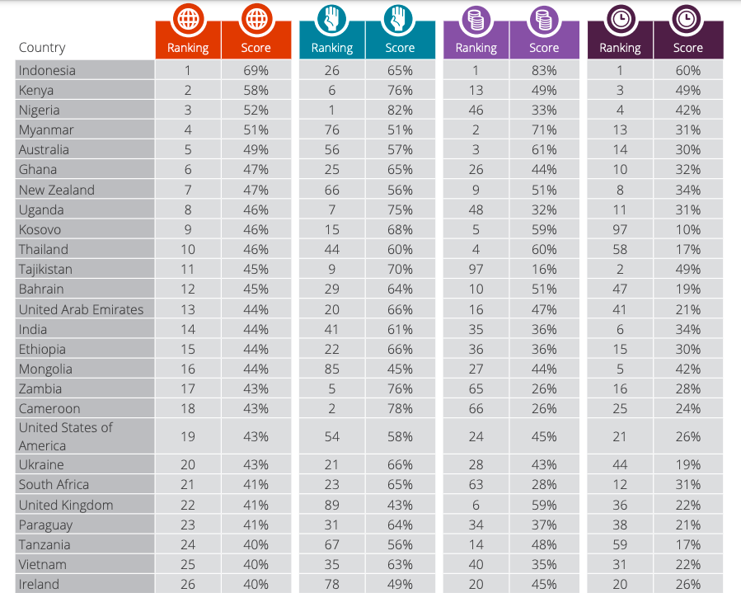

Charities Aid Foundation
CAF World Giving Index 2021

Slide 5
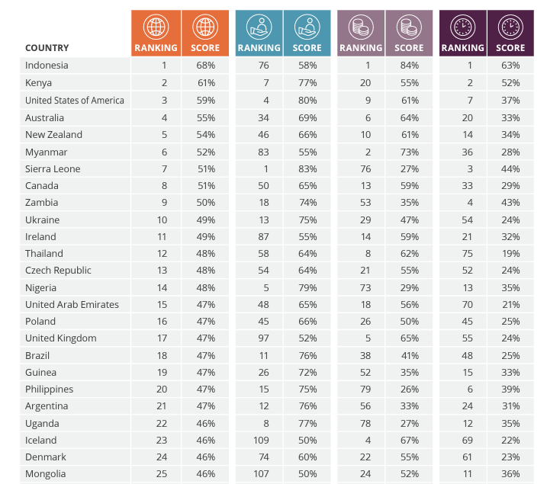
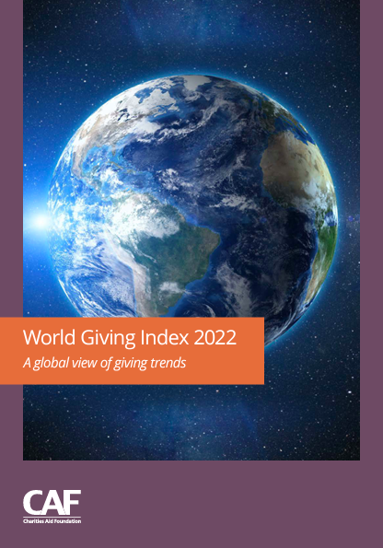
Charities Aid Foundation
CAF World Giving Index 2022

Slide 6



Global Trends
30% volunteer formally through an organisation
New volunteers are engaging in different forms of volunteering:
Virtual
Online
Micro
Slacktivism
Emergency volunteering
70% volunteer informally for other individuals
Source: The State of volunteering report, Un Volunteer Programme 2021

Slide 7

Trends in Ireland
Post Covid-19
47%
Pre Covid-19
32%
Increasing numbers of 18-24 year olds volunteering
54% of people looking for short term / episodic volunteering
During
16%
Source: Volunteering and Covid-19, Volunteer Ireland

Slide 8





Five components of volunteering
Structure
Site
Intensity
Aspiration
Category
United Nations Volunteers (UNV) programme (2021).
2022 State of the World’s Volunteerism Report. Building equal and inclusive societies. Bonn.

Slide 9
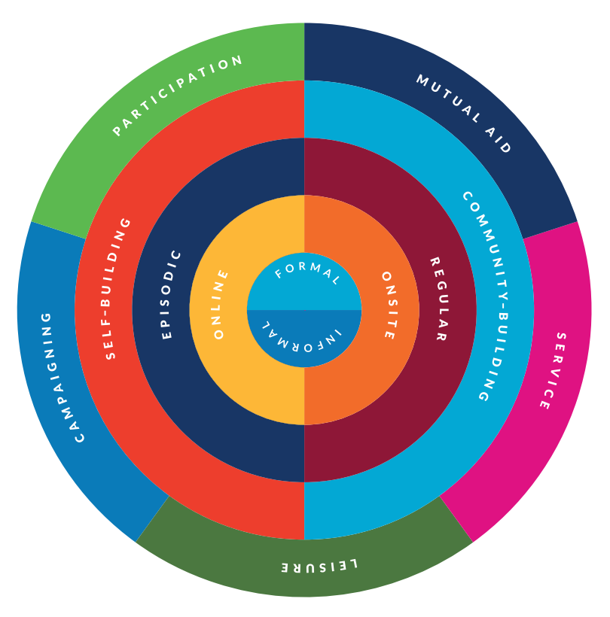
United Nations Volunteers (UNV) programme (2021).
2022 State of the World’s Volunteerism Report. Building equal and inclusive societies. Bonn.

Slide 10
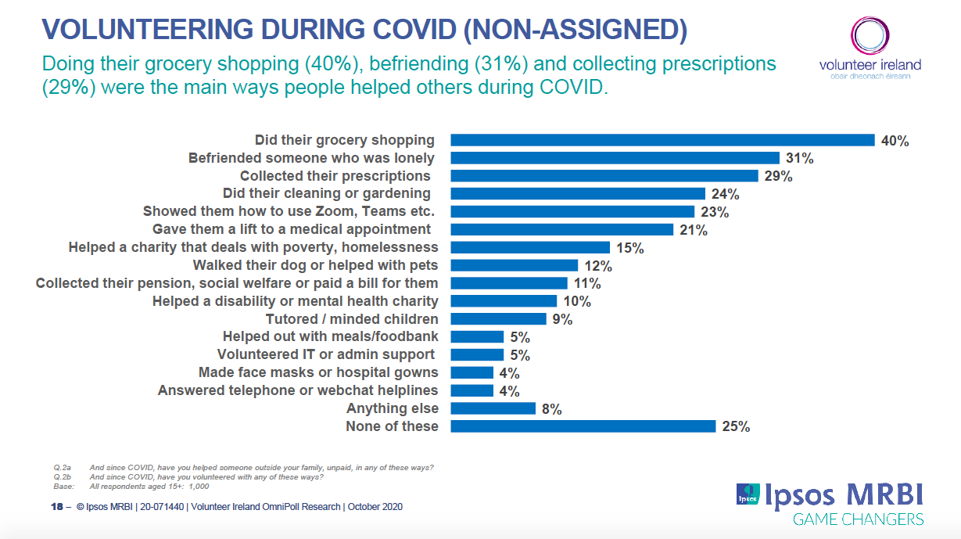

Slide 11
Volunteers in general
There are unfilled jobs right now. People are opting for paid work instead of volunteer work
People are growing more distrustful of not for profit organisations, and that’s keeping them from coming to us to volunteer
People learned to love being at home
Other VIOs with more resources have more to offer
People have had enough of the pandemic, a war in Ukraine and the cost of living crisis
People have too much on to care about their communities now
Are you
finding it
hard to
recruit
now?

Slide 12
Youth Volunteers in general
The offer is not the right one for youth volunteers
“They won’t commit, they are unreliable”
“They spend all their time on their phones and computers”
“They aren’t the same as us, they want more We don’t know where to find them”
There are far too many competing offers today (Netflix, On demand TV, YouTube, Twitch, TikTok, and other streaming Services) which appear to appeal to young people
Are you
finding it
hard to
recruit
now?

Slide 13
Some groups gain more than others
People
in later
years of
life
People
from lower
socio-
economic
groups
The
unemployed
People
living with
physical
health
conditions
People with
lower levels
of wellbeing
Stuart, J. and Abreu Scherer, I. (2020) Volunteer wellbeing: what works and who benefits?,
What Works Centre for Wellbeing and Spirit of 2012

Slide 14
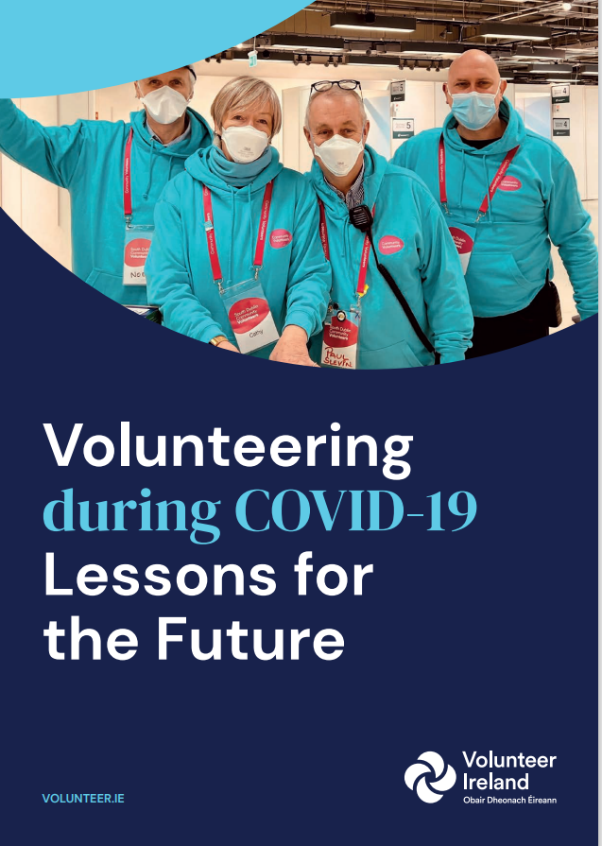
Lessons for the future
A 2021 survey conducted as part of the research found that volunteering had a significant impact on those who gave back during the pandemic:
72.6% of volunteers who volunteered during COVID-19 indicated that their feeling of making a useful contribution to the community increased
50.8% of volunteers who volunteered during COVID-19 indicated that their mental health and well-being increased
57.4% of volunteers who volunteered during COVID-19 indicated that their sense of belonging to the community increased
95.6% of volunteers agreed with the statement that ‘without volunteers, many people would be left without help and/or services’
95% of volunteers agreed with the statement that ‘volunteers provide valuable services that would not otherwise be available’

Slide 15
Lessons for the future
Recommendations for organisations:
Communication is the key
Adaptability and Flexibility
Support and Training
Advertising and Promotion

Slide 16



Thank you for your attention
Any comments or questions?
Stuart Garland
Learning & Capacity Building Manager,
Volunteer Ireland
www.volunteer.ie
stuart@volunteer.ie @VoluntIreland @StuartGarland

