Slide 1





Volunteering as an effective vehicle for citizen engagement and a true social transformation
Citizen Engagement for Recovery
- Volunteering in Solidarity
#CERVIS
Project No. 101051597
(Revealing European Values In Volunteering in Europe - REVIVE Project No. 101051131)
Citizen Engagement for Recovery
- Volunteering in Solidarity.
29 November 2022 Ljubljana
Gabriella Civico Director
Centre for European Volunteering

Slide 2
CERVIS Project
Citizen Engagement for Recovery
- Volunteering in Solidarity
#CERVIS
Project No. 101051597
(Revealing European Values In Volunteering in Europe - REVIVE Project No. 101051131)
CEV works together with Its members to promote and defend:
Equality
Ensuring that every person has equal opportunities;
Rights
Civil, political, cultural, economical - Basic rights of every human being;
Values
These individual beliefs determines the way that people act/think;
Diversity of genders
The equal representation of each person of different gender;
Notes:
Talking a little bit more about where and how and who with - local, regional, national volunteering with European frameworks.

Slide 3

Equality, Rights and Diversity of Genders
Citizen Engagement for Recovery
- Volunteering in Solidarity
#CERVIS
Project No. 101051597
(Revealing European Values In Volunteering in Europe - REVIVE Project No. 101051131)

Slide 4

Volunteering:
Citizen Engagement for Recovery
- Volunteering in Solidarity
#CERVIS
Project No. 101051597
(Revealing European Values In Volunteering in Europe - REVIVE Project No. 101051131)
We focus on bringing the vision that volunteers are not just a source of people power for essential and meaningful tasks in society, but they play an important role in:
Social cohesion;
Interpersonal relationships;
Performing to making European values a reality;
We reinforce the visibility for volunteering and raise the profile of volunteers at national, regional, and local levels, by being part of a European network
Notes:
Reinforcing the impact that volunteers have in the life of others and themselves. Talking about the perks of volunteering and the support that It’s given to them by CEV (brief intro - next slide explains it)

Slide 5
What’s the Role of CEV Regarding Volunteers?
Citizen Engagement for Recovery
- Volunteering in Solidarity
#CERVIS
Project No. 101051597
(Revealing European Values In Volunteering in Europe - REVIVE Project No. 101051131)
CEV allow’s volunteers voices to be heard;
CEV also works for the recognition of volunteering;
But mainly we focus on capacity building in volunteering organisations so that they can be more inclusive and equal in the way that they engage volunteers.
In this way we advance gender equality and tackle multiple and intersecting discrimination in the volunteering sector itself.
Notes:
1 - Speak about the diversity of discriminating factors like diversity of genders - EU level - the policy makers begin to be more aware of these situations regarding these concerns - the gap between the relationship of volunteers and policymakers
2 - Talking about the European Volunteering Capital Competition

Slide 6

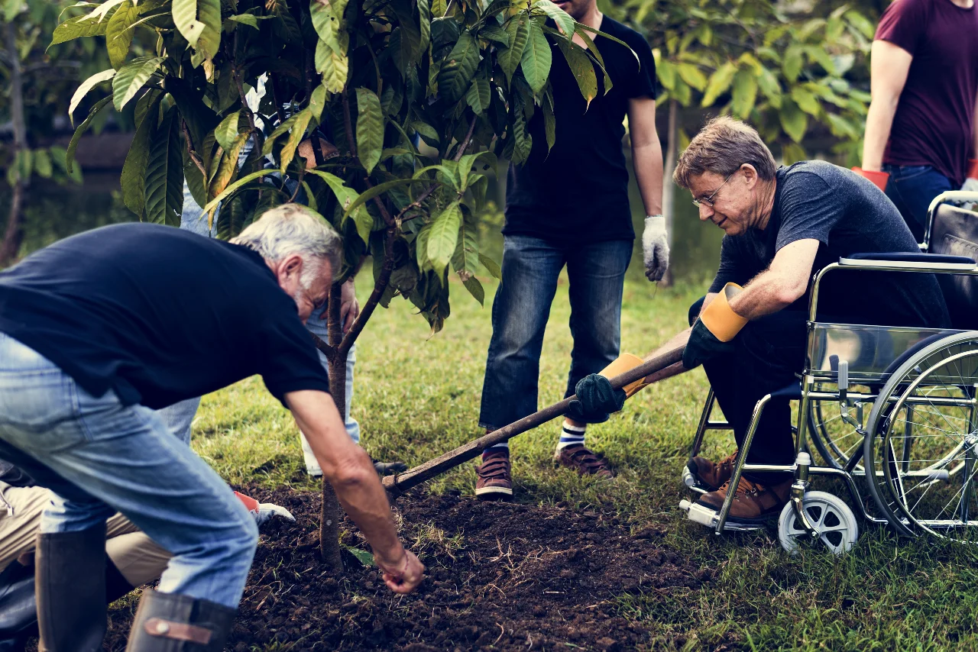

Inclusive Volunteering
Citizen Engagement for Recovery
- Volunteering in Solidarity
#CERVIS
Project No. 101051597
(Revealing European Values In Volunteering in Europe - REVIVE Project No. 101051131)
Notes:
In this picture you can approach that volunteering is inclusive and for all.

Slide 7
The Benefits of Becoming a Volunteer
Citizen Engagement for Recovery
- Volunteering in Solidarity
#CERVIS
Project No. 101051597
(Revealing European Values In Volunteering in Europe - REVIVE Project No. 101051131)
Volunteering is an effective vehicle for citizen engagement, and it is a main agent of a true social transformation.
It supports:
Social inclusion;
Equality;
Solidarity;
Active citizenship;
Community resilience;
Promotes shared responsibilities and European values;

Slide 8
How volunteering is increasing?
Citizen Engagement for Recovery
- Volunteering in Solidarity
#CERVIS
Project No. 101051597
(Revealing European Values In Volunteering in Europe - REVIVE Project No. 101051131)
Volunteering has been growing over the last years.
We are witnessing an increase of activism and volunteering crossing borders that connect people who are inspired and driven to respond to global challenges such as climate change, war, migrations, COVID-19.
Volunteering contributes to the European Social model to:
  Security;
  Peace;
  Cohesion;
  Recovery;
  Prosperity;
Supplies for a better future of Europe “fighting” and resisting extremist and populist views, ideologies, actions, and can contribute to their prevention;
Being a volunteer is also preventing hate speech, striving for based on democratic values and other great purposes such as inclusiveness and tolerance;
Notes:
Speaking a little bit more about the consciousness regarding the volunteering and the evolution of it for bigger purposes such as russian/ukrainian war.
Addressing this as how solidarity is important.
Reinforce the challenges and inequalities, as well as the need to protect rights and support vulnerable people

Slide 9
Visibility and Raising Awareness
Citizen Engagement for Recovery
- Volunteering in Solidarity
#CERVIS
Project No. 101051597
(Revealing European Values In Volunteering in Europe - REVIVE Project No. 101051131)
The provisions and support for civil society, volunteering and volunteers involving the full diversity of genders and other discriminating factors that are enabled under different EU policies such as the European Democracy Action Plan and programmes such as:
CERV (Citizens, Equality, Rights and Values Program);
The “Next Generation EU” funds
European Solidarity Corps;
Erasmus Plus;
And other EU funding and policy;
Notes:
Speaking a little more about these programs

Slide 10
Conference on the Future of Europe
Citizen Engagement for Recovery
- Volunteering in Solidarity
#CERVIS
Project No. 101051597
(Revealing European Values In Volunteering in Europe - REVIVE Project No. 101051131)
How do the conclusions of the Conference on the Future of Europe respond to the needs of citizens wishing to take part in a spirit of solidarity and engage in volunteering projects/initiatives for the sake of contribution to the post-COVID19 recovery and overall resilience and defence of EU Values?
Climate change and the environment;
Health;
A stronger economy, social justice and jobs;
EU in the World;
Values and rights, rule of law, security;
Digital Transformation;
European democracy;
Migration;
Education, culture, youth and sport;
Notes:
Speaking about what volunteering actions and activities can come under each topic?

Slide 11
Small Group Discussions
Citizen Engagement for Recovery
- Volunteering in Solidarity
#CERVIS
Project No. 101051597
(Revealing European Values In Volunteering in Europe - REVIVE Project No. 101051131)
How can the conclusions of the Conference on the Future of Europe respond to the needs of people wishing to engage in a spirit of solidarity and engage in volunteering projects and initiatives? How do they help us become more transformative and more effective?
How can, and are, volunteers contributing to the post-COVID19 recovery and the cost of living crisis?
In what ways should the Slovenian volunteering law and youth strategy reflect the outcomes of the Conference on the Future of Europe and the conclusions of the Civil Society Convention for the Conference on the Future of Europe?

Slide 12

Citizen Engagement for Recovery
- Volunteering in Solidarity
#CERVIS
Project No. 101051597
(Revealing European Values In Volunteering in Europe - REVIVE Project No. 101051131)

Slide 13









Citizen Engagement for Recovery
- Volunteering in Solidarity
#CERVIS
Project No. 101051597
(Revealing European Values In Volunteering in Europe - REVIVE Project No. 101051131)
THANK YOU!
Follow us on Facebook, Twitter, Youtube and Instagram for more from CEV and our members.
@VolunteeringCEV
@VolunteeringCEV
@volunteeringcev
Centre for European Volunteering CEV
CEV-Centre for European Volunteering
www.europeanvolunteercentre.org

